Slide 1



Research methodology in Psych
BY: AQSA FAYYAZ
Lecturer
(Science and Humanities)
FAST - National University of Computer & Emerging Sciences

Slide 2




By the end of this lesson, we’ll be able to:
What is research.
Describe the steps involved in the scientific method.
Types of researches, variables, Research methods
Apply the scientific method to a specific problem.
Ethical considerations.

Slide 3

Research
Systematic Inquiry: Research follows a structured approach to collect and analyze information.
Knowledge Expansion: It seeks to generate new insights, confirm existing theories, or explore different areas.
Problem Solving: Research can address specific questions or issues, leading to practical solutions or advancements in a field.

Slide 4


Types of Research
Basic Research: Also known as fundamental or pure research, it focuses on expanding theoretical knowledge without immediate practical application.
For example, studying cognitive processes to understand how memory works.
Applied Research: It aims to solve specific, practical problems and often involves direct application of theories.
For examples: Developing new educational strategies based on cognitive research.

Slide 5



The Scientific Method
It is a process of investigation to find or produce measurable and reliable results that answer a specific question.

Slide 6
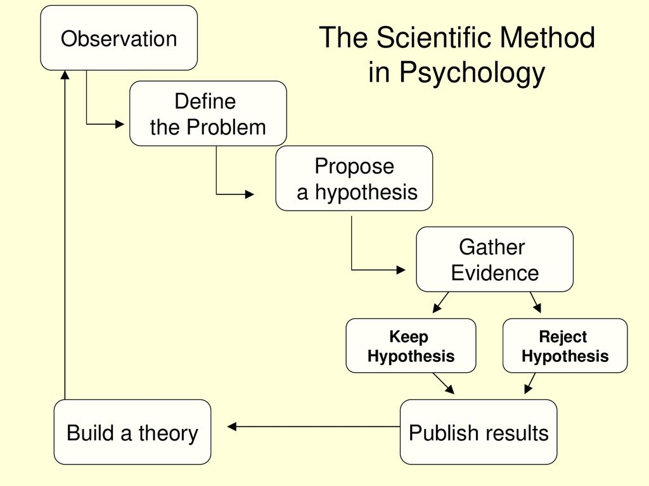

Slide 7





1.
Observation
These are the things or information we note by using our five senses. It is the way we notice important details in our surroundings.
You observe that plants grow in different directions.

Slide 8


2.
Question
The details we noticed during observation will spark our curiosity. The most interesting ones will make us ask questions that we want answered.
“What makes a plant grow in a certain direction?”

Slide 9


3.
Research
It is important to look up what is already known. Research opens us up to answered and unanswered questions about our topic.
It also prepares us for the next step in this process.
You learn about phototropism, or how plants respond to a light source.

Slide 10



4.
Hypothesis
It is the tentative explanation to our initial question based on what we know so far.
As scientists or science learners, our initial research and keen observation equip us to form informed hypotheses.
The direction of the plant growth depends on the location of the light source.

Slide 11

5.
Experiment
This is the stage where we get to test our hypothesis. It can be a test or a series of tests done in a controlled environment to validate our observations and answer our questions.
You can set up an experiment using plants. Record your data thoroughly.

Slide 12
Variables
The direction of the plant growth depends on the location of the light source.
A variable in research is something that can change or have different values and is studied by the researcher.
Independent Variable: The variable that is manipulated or changed in the experiment.
Dependent Variable: The variable that is measured or observed to assess the effect of the independent variable.
Control Variables: Factors that are kept constant to ensure that any changes in the dependent variable are due to the manipulation of the independent variable.
Confounding variables: A confounding variable is an extra factor that can affect the results of a research study, making it difficult to know whether the independent variable really caused the change.
For example:
🌱 Independent variable: Location of the light source — the factor that is changed.
🌿 Dependent variable: Direction of plant growth — the factor that is observed or measured.
💧 Control Variable: Amount of water, soil type, temperature
Confounding variable: Wind, if it affects the plant's growth

Slide 13
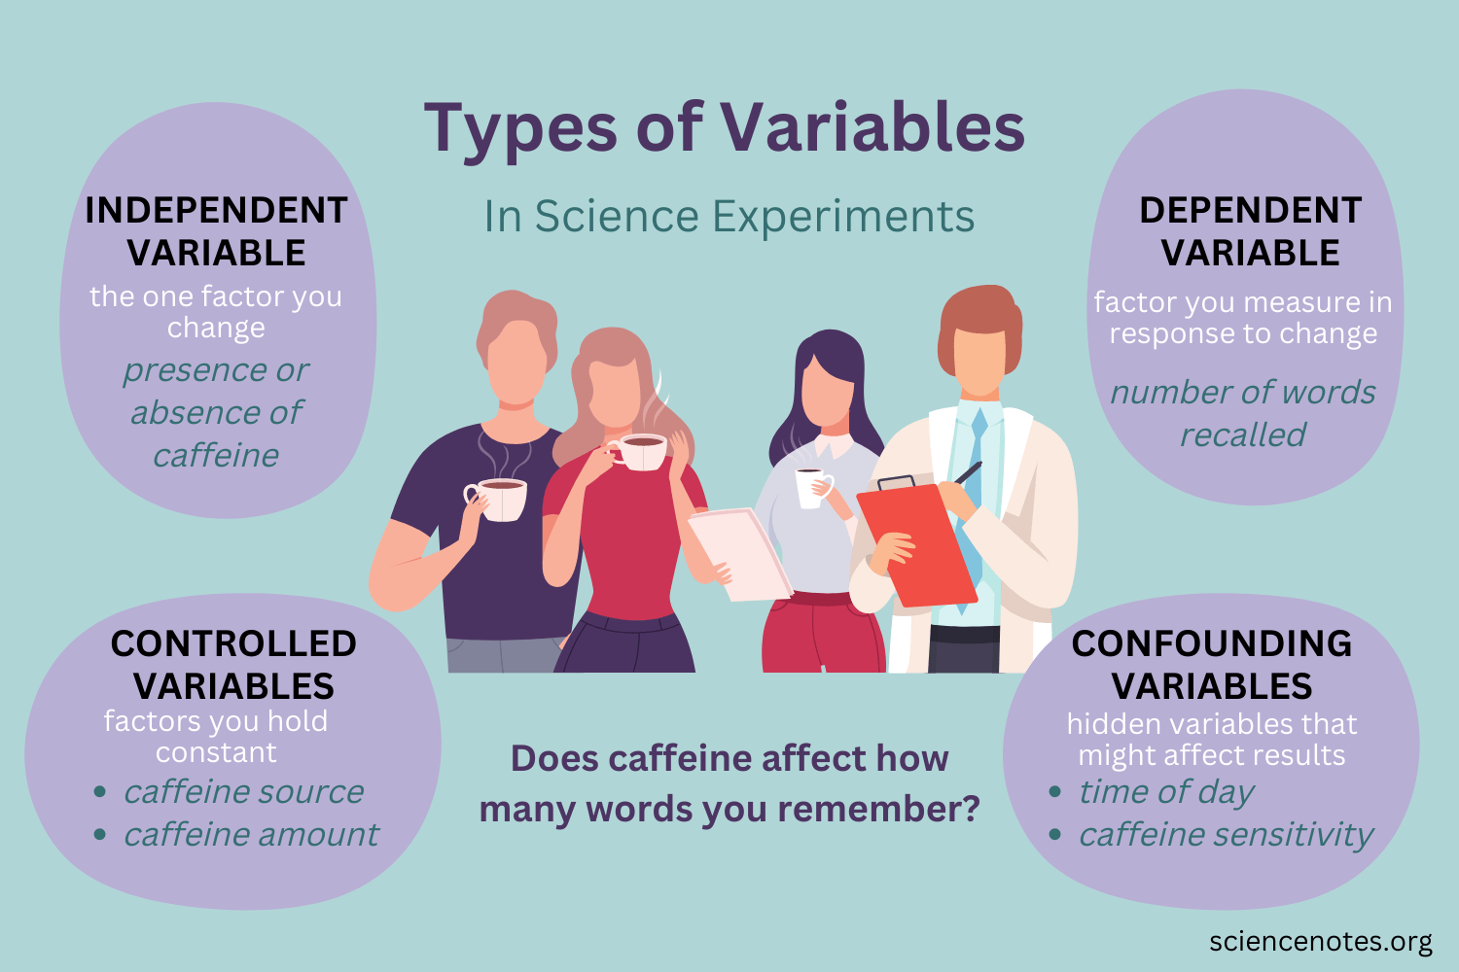

Slide 14

6.
Analysis
This is when we compare our expected results with our actual results. We gather measurable results that can prove if our hypothesis is true or false.
What worked and did not work during your experiment?

Slide 15


7.
Conclusion
We draw conclusions from our analysis. Our conclusion summarizes the information we gathered during the scientific process and shares if our hypothesis is correct or can be supported.
Do the results of your experiment answer your research question and hypothesis?

Slide 16






The Scientific Method: Process Recap
Observation
Question
Research
Remember that the scientific method is a complex and flexible process rather than a strict set of steps.
Hypothesis
Experiment
Analysis
Conclusion

Slide 17

Observation: Students frequently use digital wallets.
Question: Do digital wallets increase spending?
Hypothesis: Digital wallet users spend more.
Experiment: Survey 50 students about wallet use and spending.
Analysis: Compare spending of frequent and less-frequent users.
Conclusion: Determine whether digital wallets increase spending.
Eg 1: Digital Wallets

Slide 18

Research Methods
1. Qualitative Research
Focuses on understanding experiences, opinions, and behaviors using:
Interviews
Observations
Case studies
2. Quantitative Research
Focuses on collecting and analyzing numerical data using:
Surveys and questionnaires
Experiments
Statistical analysis
3. Mixed Methods Research
Combines qualitative and quantitative approaches to gain a more complete understanding of a research problem.

Slide 19
Research Methods
4. Descriptive
Describes the characteristics, behaviors, opinions, or situations of a particular group or phenomenon.
without trying to change or control the situation.
E.g.: Survey students about study habits
5. Experimental
Tests cause and effect, focuses on WHY is it happening
E.g.: Test whether a new teaching method improves grades
6.Correlational
Finds relationships, whether two or more variables are related to each other
E.g.: Study the link between study time and exam scores, Exercise ↔ Stress level

Slide 20

Ethical Considerations
Ethical considerations in research are the principles and guidelines that researchers follow to protect participants, maintain honesty, and ensure that research is conducted responsibly.
KEY ETHICAL CONSIDERATIONS INCLUDE:
Informed Consent – Participants should be clearly informed about the purpose, procedures, risks, and benefits of the study before agreeing to participate.
Voluntary Participation – Participants should take part willingly and should not be forced or pressured to participate.

Slide 21
Confidentiality and Privacy – Personal information and research data should be kept private and protected from unauthorized access.
Anonymity – Where possible, participants' identities should not be connected to the information they provide.
Avoidance of Harm – Researchers should minimize physical, psychological, social, or emotional harm to participants.
Right to Withdraw – Participants should be allowed to leave the study at any time without punishment or negative consequences.

Slide 22


Justice and Fairness – Participants should be selected fairly, and no group should be unfairly burdened or excluded.
Ethical Approval – Research involving human participants should generally be reviewed and approved by an appropriate ethics committee or institutional review board before it begins.

Slide 23
Academic and Scientific: Contributing to the body of knowledge in various fields such as psychology, medicine, or Fintech
Research on Artificial Intelligence, blockchain, digital payments, cryptocurrency, and financial behavior helps develop new knowledge in finance and technology.
Professional and Practical: Research helps improve real-world practices, business decisions, and policies.
Research can help banks and FinTech companies improve digital banking, detect fraud, manage financial risks, protect customer data, and develop better financial products.
Applications of Research

Slide 24


It ends and begins again with COMMUNICATION
The entire scientific process leads us to new information.
When shared, they can be used in future studies.
Many of today’s technologies and knowledge started from a hypothesis that someone took time to test and share their results with the world.

Slide 25




THANKYOU!

